Slide 1
Today
The Need for Databases
Data Models
Relational Databases
Database Design
Transaction Manager

Slide 2
How Big is Petabyte?
First we must understand a Gigabyte
1 GB = 7 Minutes of HD-TV Video
2 GB = 20 Yards of Books on a shelf
4.7 GB = A standard DVD
1 Gigabyte
1024 Gigabytes = 1 Terabyte
1024 Terabyte= 1 Petabyte
Source – Mozy.com

Slide 3
The NSA
is thought to analyze 1.6% of all global internet traffic – around 30 petabytes (30 million gigabytes) every day.
Source

Slide 4

















Social Media
Banking
Finance
Gaming
Our
Known
History
You
Entertain
Purchase

Slide 5
Database Management System (DBMS)
DBMS contains information about a particular enterprise
Collection of interrelated data
Set of programs to access the data
An environment that is both convenient and efficient to use
Database Applications:
Banking: transactions
Airlines: reservations, schedules
Universities: registration, grades
Sales: customers, products, purchases
Online retailers: order tracking, customized recommendations
Manufacturing: production, inventory, orders, supply chain
Human resources: employee records, salaries, tax deductions
Databases can be very large.
Databases touch all aspects of our lives
Notes:
5

Slide 6
University Database Example
Application program examples
Add new students, instructors, and courses
Register students for courses, and generate class rosters
Assign grades to students, compute grade point averages (GPA) and generate transcripts
In the early days, database applications were built directly on top of file systems
Notes:
6

Slide 7
Drawbacks of using file systems to store data
Data redundancy and inconsistency
Multiple file formats, duplication of information in different files
Difficulty in accessing data
Need to write a new program to carry out each new task
Data isolation
Multiple files and formats
Integrity problems
Integrity constraints (e.g., account balance > 0) become “buried” in program code rather than being stated explicitly
Hard to add new constraints or change existing ones
Notes:
7

Slide 8
Drawbacks of using file systems to store data (Cont.)
Atomicity of updates
Failures may leave database in an inconsistent state with partial updates carried out
Example: Transfer of funds from one account to another should either complete or not happen at all
Concurrent access by multiple users
Concurrent access needed for performance
Uncontrolled concurrent accesses can lead to inconsistencies
Example: Two people reading a balance (say 100) and updating it by withdrawing money (say 50 each) at the same time
Security problems
Hard to provide user access to some, but not all, data
Database systems offer solutions to all the above problems
Notes:
8

Slide 9
Levels of Abstraction
Physical level: describes how a record (e.g., instructor) is stored.
Logical level: describes data stored in database, and the relationships among the data.
type instructor = record
ID : string; name : string; dept_name : string; salary : integer;
end;
View level: application programs hide details of data types. Views can also hide information (such as an employee’s salary) for security purposes.
Notes:
9

Slide 10
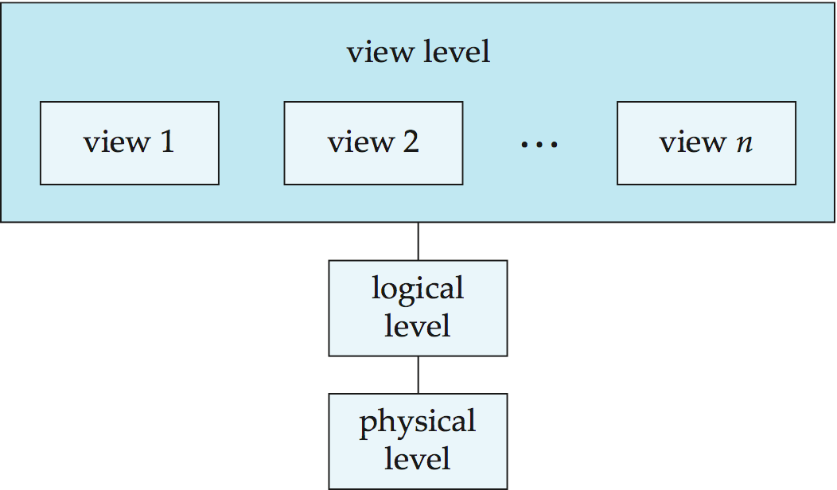
View of Data
An architecture for a database system
Notes:
10

Slide 11
Instances and Schemas
Similar to types and variables in programming languages
Logical Schema – the overall logical structure of the database
Example: The database consists of information about a set of customers and accounts in a bank and the relationship between them
Analogous to type information of a variable in a program
Physical schema– the overall physical structure of the database
Instance – the actual content of the database at a particular point in time
Analogous to the value of a variable
Physical Data Independence – the ability to modify the physical schema without changing the logical schema
Applications depend on the logical schema
In general, the interfaces between the various levels and components should be well defined so that changes in some parts do not seriously influence others.
Notes:
11

Slide 12
Data Models
A collection of tools for describing
Data
Data relationships
Data semantics
Data constraints
Relational model
Entity-Relationship data model (mainly for database design)
Object-based data models (Object-oriented and Object-relational)
Semistructured data model (XML)
Other older models:
Network model
Hierarchical model
Notes:
12

Slide 13
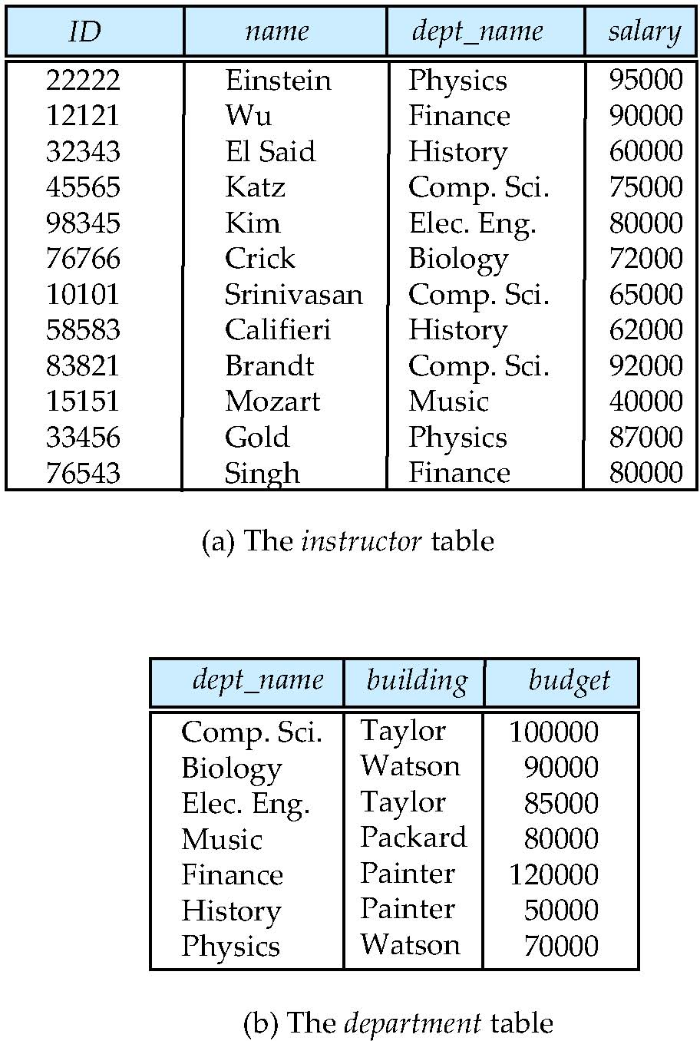
Relational Model
All the data is stored in various tables.
Example of tabular data in the relational model
Columns
Rows
Notes:
13

Slide 14
A Sample Relational Database
Notes:
14

Slide 15
Data Definition Language (DDL)
Specification notation for defining the database schema
Example: create table instructor ( ID char(5), name varchar(20), dept_name varchar(20), salary numeric(8,2))
DDL compiler generates a set of table templates stored in a data dictionary
Data dictionary contains metadata (i.e., data about data)
Database schema
Integrity constraints
Primary key (ID uniquely identifies instructors)
Authorization
Who can access what
Notes:
15

Slide 16
Data Manipulation Language (DML)
Language for accessing and manipulating the data organized by the appropriate data model
DML also known as query language
Two classes of languages
Pure – used for proving properties about computational power and for optimization
Relational Algebra
Tuple relational calculus
Domain relational calculus
Commercial – used in commercial systems
SQL is the most widely used commercial language
Notes:
16

Slide 17
SQL
The most widely used commercial language
SQL is NOT a Turing machine equivalent language
SQL is NOT a Turing machine equivalent language
To be able to compute complex functions SQL is usually embedded in some higher-level language
Application programs generally access databases through one of
Language extensions to allow embedded SQL
Application program interface (e.g., ODBC/JDBC) which allow SQL queries to be sent to a database
Notes:
17

Slide 18
Database Design
The process of designing the general structure of the database:
Logical Design – Deciding on the database schema. Database design requires that we find a “good” collection of relation schemas.
Business decision – What attributes should we record in the database?
Computer Science decision – What relation schemas should we have and how should the attributes be distributed among the various relation schemas?
Physical Design – Deciding on the physical layout of the database
Notes:
18

Slide 19
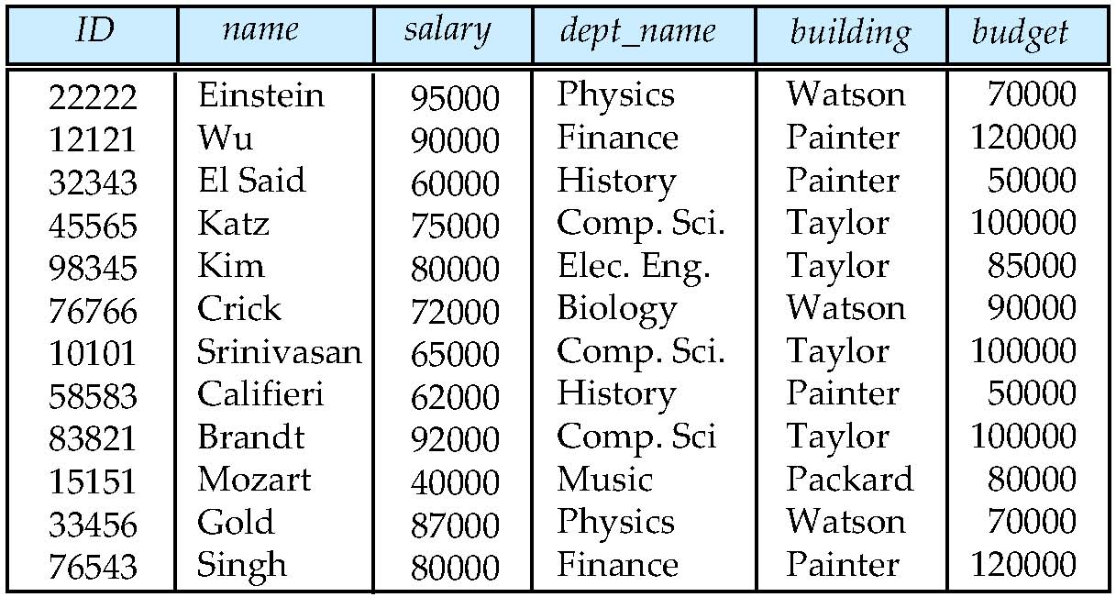
Database Design (Cont.)
Is there any problem with this relation?
Notes:
19

Slide 20
Design Approaches
Need to come up with a methodology to ensure that each of the relations in the database is “good”
Two ways of doing so:
Entity Relationship Model
Models an enterprise as a collection of entities and relationships
Represented diagrammatically by an entity-relationship diagram:
Normalization Theory
Formalize what designs are bad, and test for them
Notes:
20

Slide 21
Object-Relational Data Models
Relational model: flat, “atomic” values
Object Relational Data Models
Extend the relational data model by including object orientation and constructs to deal with added data types.
Allow attributes of tuples to have complex types, including non-atomic values such as nested relations.
Preserve relational foundations, in particular the declarative access to data, while extending modeling power.
Provide upward compatibility with existing relational languages.
Notes:
21

Slide 22
Database Engine
Storage manager
Query processing
Transaction manager
Notes:
22

Slide 23
Storage Management
Storage manager is a program module that provides the interface between the low-level data stored in the database and the application programs and queries submitted to the system.
The storage manager is responsible to the following tasks:
Interaction with the OS file manager
Efficient storing, retrieving and updating of data
Issues:
Storage access
File organization
Indexing and hashing
Notes:
23

Slide 24
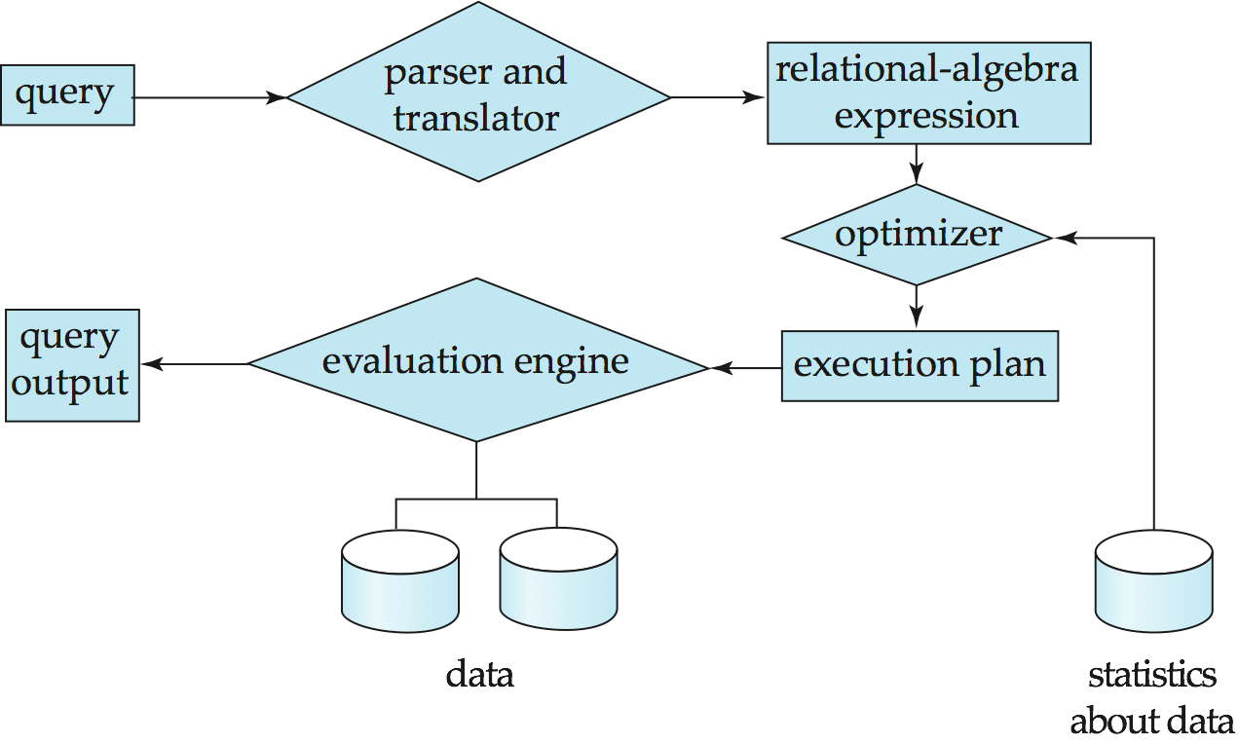
Query Processing
1. Parsing and translation
2. Optimization
3. Evaluation
Notes:
24

Slide 25
Query Processing (Cont.)
Alternative ways of evaluating a given query
Equivalent expressions
Different algorithms for each operation
Cost difference between a good and a bad way of evaluating a query can be enormous
Need to estimate the cost of operations
Depends critically on statistical information about relations which the database must maintain
Need to estimate statistics for intermediate results to compute cost of complex expressions
Notes:
25

Slide 26
Transaction Management
What if the system fails?
What if more than one user is concurrently updating the same data?
A transaction is a collection of operations that performs a single logical function in a database application
Transaction-management component ensures that the database remains in a consistent (correct) state despite system failures (e.g., power failures and operating system crashes) and transaction failures.
Concurrency-control manager controls the interaction among the concurrent transactions, to ensure the consistency of the database.
Notes:
26

Slide 27
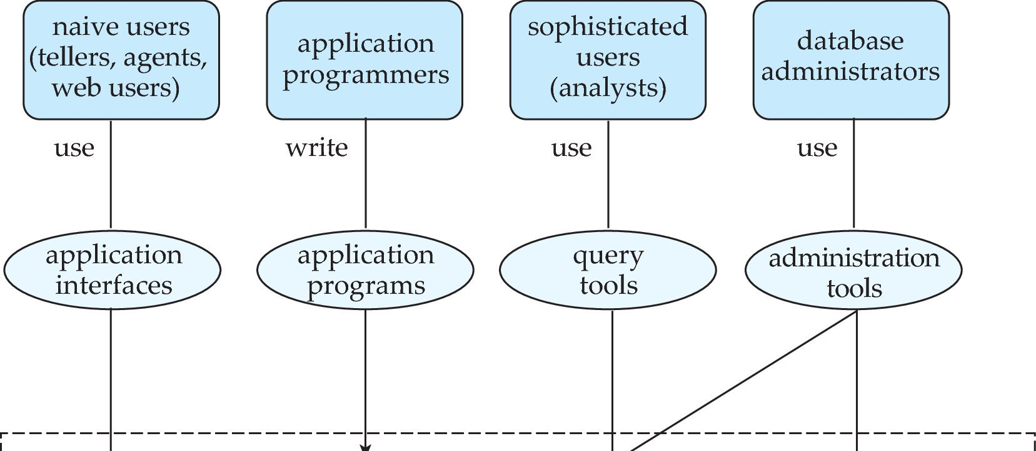
Database Users and Administrators
Database
Notes:
27

Slide 28
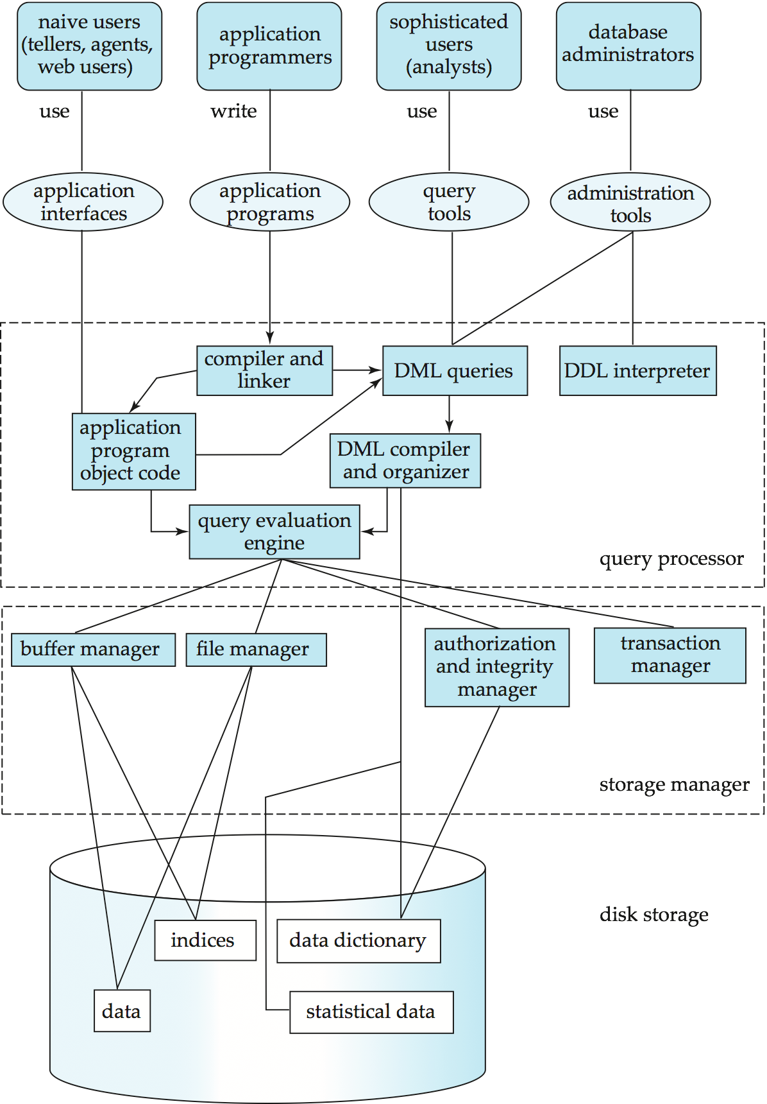
Database System Internals
Notes:
28

Slide 29
Database Architecture
The architecture of a database systems is greatly influenced by
the underlying computer system on which the database is running:
Centralized
Client-server
Parallel (multi-processor)
Distributed
Notes:
29

Slide 30
History of Database Systems
1950s and early 1960s:
Data processing using magnetic tapes for storage
Tapes provided only sequential access
Punched cards for input
Late 1960s and 1970s:
Hard disks allowed direct access to data
Network and hierarchical data models in widespread use
Ted Codd defines the relational data model
Would win the ACM Turing Award for this work
IBM Research begins System R prototype
UC Berkeley begins Ingres prototype
High-performance (for the era) transaction processing
Notes:
30

Slide 31
History (cont.)
1980s:
Research relational prototypes evolve into commercial systems
SQL becomes industrial standard
Parallel and distributed database systems
Object-oriented database systems
1990s:
Large decision support and data-mining applications
Large multi-terabyte data warehouses
Emergence of Web commerce
Early 2000s:
XML and XQuery standards
Automated database administration
Later 2000s:
Giant data storage systems
Google BigTable, Yahoo PNuts, Amazon, ..
Notes:
31

Slide 32
Process Modeling and ERD
Logical Database Design: Data Modeling

Slide 33
Data Modeling
Description of a Business: interviews, narrative, documents
Business Data Modeling (your task today)
Specs to build or change a Database (an ERD data model)
Data modeling is a bedrock problem

Slide 34
Using a divide-and-conquer approach to building databases
Business
information
Hardest
Logical ERD (our focus)
Physical: table specs
Implemented data structures (SW & HW)
Note: we differ from Hoffer et al. – this is just another way to express similar ideas

Slide 35
Process Modeling Next Week
Friday Afternoon
Saturday Morning
Saturday Afternoon
Monday Today Next Week
Business Process Management
BP Modeling 1. “Pure” BPM
Workshop
2. ERD
Data Modeling - Graded

Slide 36
What is a Business Process?
a sequence of steps that achieve a business goal.

Slide 37
What is a Business Process Model?
Business Process
Making
Servicing
Selling
modeling
BP models are text and/or graphics that describe business processes: flowcharts, list of steps, recipes, storyboards, programs. Many types and techniques.

Slide 38
What do you use BP models for?
Management tool
BP assessment and improvement: identifying inefficiencies, metrics, costing, training…
Engineering tool
sketching, blueprinting, programming
Making
Servicing
Selling

Slide 39

Process modeling is much like summarizing a movie for a friend
What makes a summary good?
Is there such a thing as a wrong summary?
Can a summary be factually correct and bad?
Is the audience important?
Is the language (idiom, syntax, grammar…) important?
What if there is a syntax/grammar error in the summary?

Slide 40


“Pure” BP Modeling
Describe the process of buying groceries by writing down half a dozen key steps

Slide 41
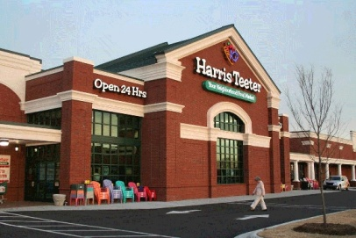
Before jumping into modeling the process of buying groceries...
Step back and identify the 3 Ps:
Purpose:
Why are we modeling? As-is, to be?
Process:
What is this process, exactly? Beginning/end?
Perspective:
Who does it?

Slide 42
“Pure” BP Modeling
Describe the process of buying groceries by writing down half a dozen key steps
Cashier perspective
Customer
perspective

Slide 43
Buying Groceries - Narrative
Customer
perspective
The customer enters the store, browses the items, picks what she/he wants to buy, lines up at the cash register, optionally presents a loyalty card to the cashier, redeems coupons, pays, picks up the bagged items and exits the store.
Notes:
“After the customer has returned the previously rented videos, the sales associate identifies the customer and enters the videos to be rented in the system. The system then determines the total payment. The associate obtains the payment and delivers the videos to the customer.”

Slide 44
Buying Groceries - Key Steps
Cashier perspective
Greet the Customer,
Ask for membership card,
Scan the items,
Check legal age,
Redeem coupons,
Receive payment,
Bag the items.
Notes:
“After the customer has returned the previously rented videos, the sales associate identifies the customer and enters the videos to be rented in the system. The system then determines the total payment. The associate obtains the payment and delivers the videos to the customer.”

Slide 45
A “Pure” BP Model has only processes
Ask for membership card
Greet customer
Scan the Items
Bag the items
Check legal age
Redeem coupons
Receive payment
= temporal precedence
Notes:
“After the customer has returned the previously rented videos, the sales associate identifies the customer and enters the videos to be rented in the system. The system then determines the total payment. The associate obtains the payment and delivers the videos to the customer.”

Slide 46
What if…
I asked you to write down 4 steps? Possible?
I asked you to write down 40 steps? Possible?
What are the tradeoffs?

Slide 47
Another “Pure” BP Model: MBA Program
Market Program
Design Content
Select Candidates
Deliver Program
Develop Network
Perspective?
Process?
Purpose?

Slide 48
Business Processes: Takeaways
Incredibly useful. Frame for thinking.
Appreciate that BPM is cognitively challenging for some individuals
Keep in mind the 3 Ps. The answers to many question you might have about your models lie there
Many “right” solutions and some wrong ones
Good process models seem obviously clear

Slide 49
Takeaways (cont.)
Pure BP models have no technology!
Details can become overwhelming: analysis paralysis
Do not obsess on the “right” model
Begin by focusing on a typical & successful process, add detail later
Use zoom-in/zoom out techniques
Keep it simple, but do not sweep under the rug needed complexity.

Slide 50
Data modeling techniques are languages
ER Diagramming (Chen 1976)
1 - Entities
2 - Attributes
3 - Relationships

Slide 51
1 – Entities are conceptual types
Examples: Customer, Order, Stock, Employee…
Entities are not instances. Entities have instances.
Each instance must be uniquely identifiable.
ERD RDBMS
Entity Table
Instance Record
Identifier Primary key
CUSTOMER

Slide 52
Attributes are properties of entities
Example: product name, description, price…
An attribute is not a value, an attribute has a value for each instance of an entity.
CUSTOMER
CustomerID
FirstName
LastName
ERD RDBMS
Attribute Column / field Value Cell content / value

Slide 53
Identifiers are special attributes
Example: CustomerID, ProductNo, …
Identifiers must be unique
Composite identifiers
CUSTOMER
CustomerID
FirstName
LastName
ERD RDBMS
Identifier Primary key
FLIGHT
FlightID
(FlightNo, Date)
Aircraft Captain
FLIGHT
FlightNo
Date
Aircraft Captain
Equivalent

Slide 54
Types of Attributes
CUSTOMER
CustomerID
FirstName
LastName
Address (street, number, City, State, Country)
Composite attributes
Multivalued attributes
EMPLOYEE
EID
FirstName
LastName
{Certification}

Slide 55
3 – Relationships express associations between entities
examples: “has,” “is_composed_of,” “works_in”
A relationship is not a process
‘customer places order’ only means that there is a list of customers and a list of orders, and that these two lists are connected, so that we know who placed what.
Common mistake
Customer
places
ERD RDBMS
Relation Foreign key
Order

Slide 56
Relationships have a Cardinality
It is the number of instances in an entity that are associated to one instance in a related entity
Upper bound
Lower bound
Loan officer
has
Customer
Lower bound
Upper bound
Read it this way: “Each loan officer has either no (zero) customers or many (n) customers. Each customer is assigned to at least one - and possibly many - loan officers.”

Slide 57
“One To Many” Relationships
Each loan officer manages many customers. All customers have one and only one loan officer.
Loan officer
manages
Customer

Slide 58
Mandatory Vs. Optional constraints
Loan officer
has
Customer
Read it this way: “Each loan officer has either no customers or many customers; each customer is assigned to at least one and at most one loan officer (loan officer is mandatory)
Loan officer
has
Customer
Read it this way: each customer is assigned to either no loan officer or at most one loan officer” (loan officer is optional)

Slide 59
“Many To Many” relationships
Each student takes at least one class. Each class may be attended by several students.
Student
takes
Class

Slide 60
Attaching information to many to many relationships
A student attend one or more classes. Each class may be attended by several students. Students get grades for each class.
Student
takes
Class
?
grade

Slide 61
Attaching information to many to many relationships
Students gets grades for each class.
REGISTRATION
Grade
Student
Class

Slide 62
Creating an Association Entity
Student
Class
Student
Student in CLASS
(“Registration”)
Class

Slide 63
Foreign Keys
A foreign key is an attribute in one entity and an identifier (primary key) in another.
Foreign keys implement the relationships between tables
LOAN OFFICER
LO_Id
CUSTOMER
Cust_ID
manages

Slide 65
IsA Relationships
Express class/subclass relationships
Inheritance & specific attributes
Example: All employees have an EID DBA may be Oracle certified, Sales reps have a territory, Drivers have DLs…
Often overused by beginners.
Employee
DBA
Sales Rep
Truck driver

Slide 66
Attaching information to many to many relationships: 2 equivalent ways
Students gets grades for each class.
Student
takes
Class
grade
REGISTRATION
Grade
Student
Class
These two ERDs are graphically different, but correspond to the same technological solution. Both are correct. We recommend that beginners choose the bottom approach, which is more explicit.

Slide 67
Different Data Modeling “Dialects”
Chen
Modified Chen (IE)
IDEF1X
0:n
1:1
Employee
works in
Dept
Employee
works in
Dept
Employee
works in
Dept
Employee
Dept

Slide 68
Different Dialects Example
Modified Chen ERD
Patient
Patient
assn to
contains
Bed
Bed
Ward
Ward
IDEF1X

Slide 69
Systems Development Life Cycle
Project Initiation
and Planning
Analysis
Logical Design
Physical Design
Our focus is on designing information stores so that they fit the needs of an organization
Implementation
Maintenance

